Slide 1


www.maaldo.pk

Slide 2
Module 1 : Cosmetic Changes in the App

Slide 3
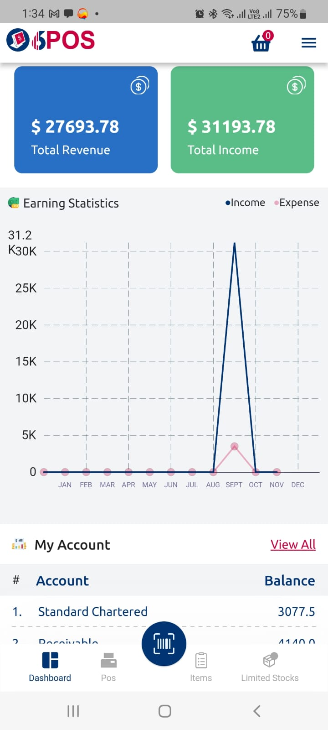
Action Points
In-app icons to be placed with new custom icons

Slide 4
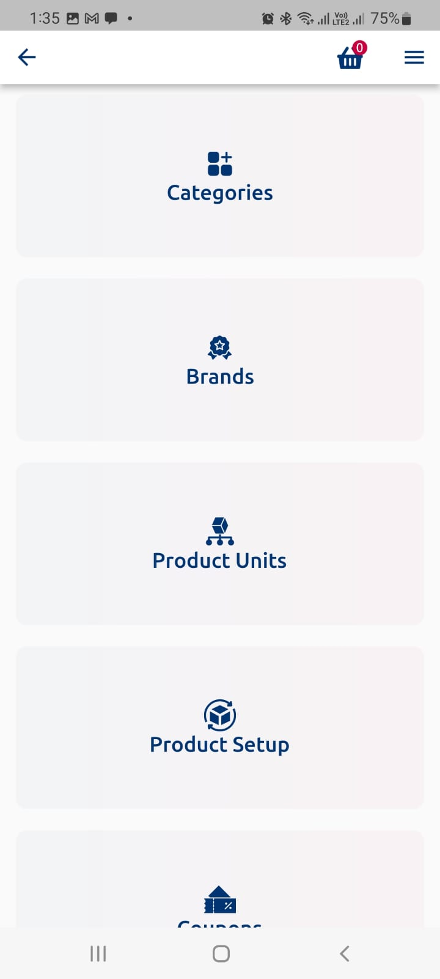
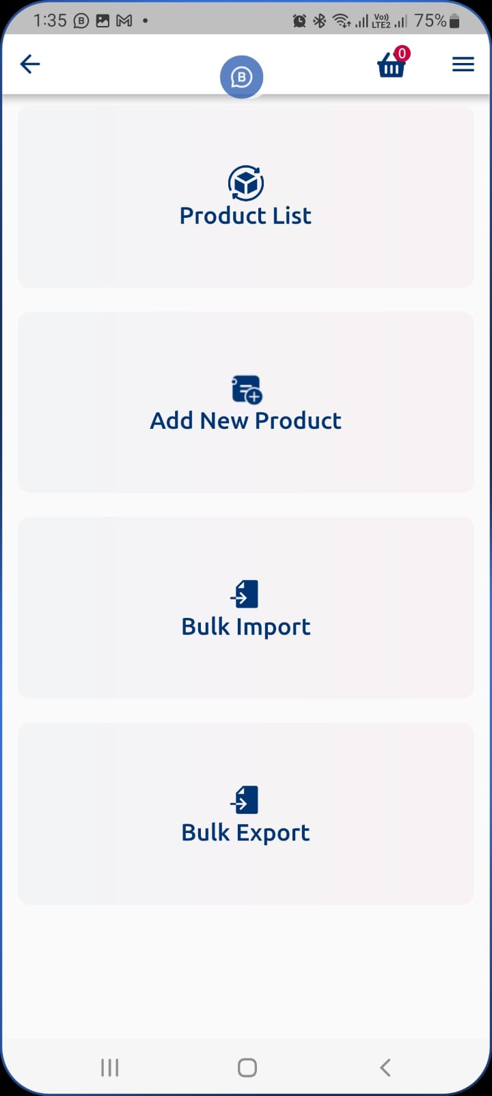
Window 1
Action Points
Product setup features to be placed within window 1

Slide 5
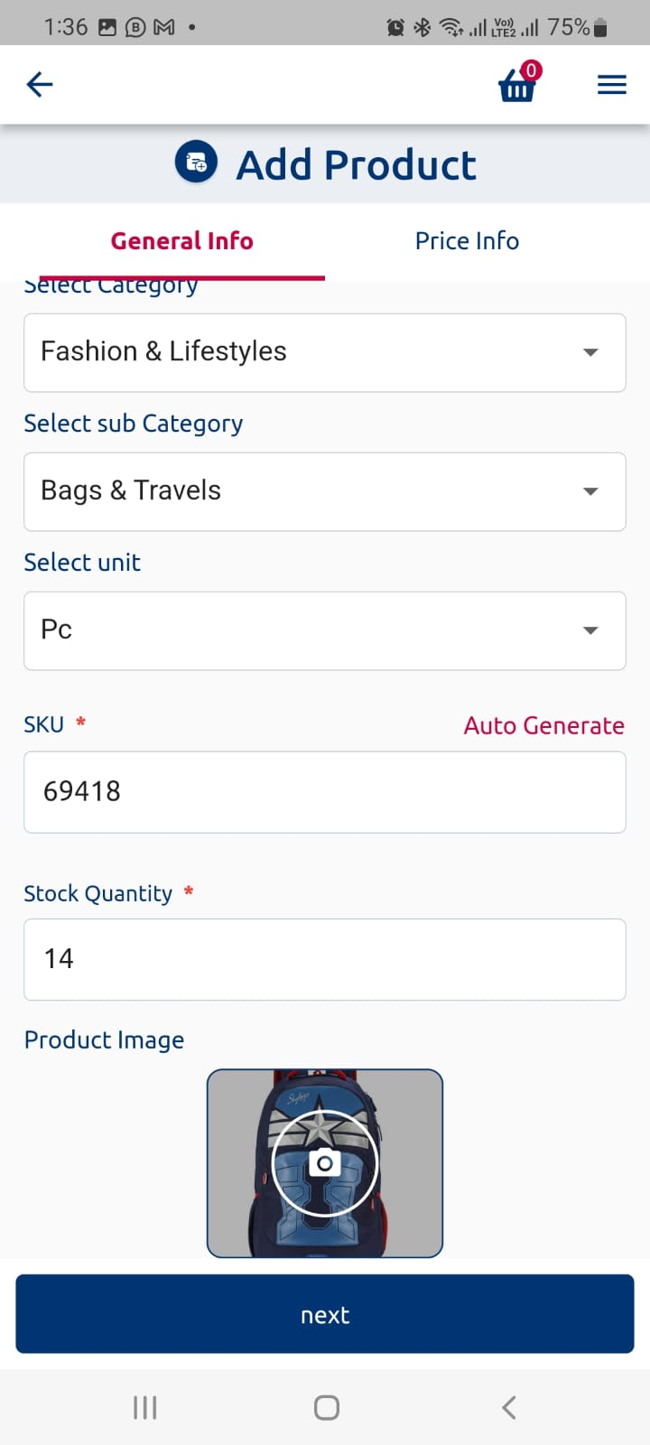
Action Points
In-camera feature to be added in SKU code where bar code can be get through by scanning.
Which ever product is added by any shopper , it will be reflected on maaldo’s main product database.
Alert quantity should be as mentioned in the previous slide

Slide 6
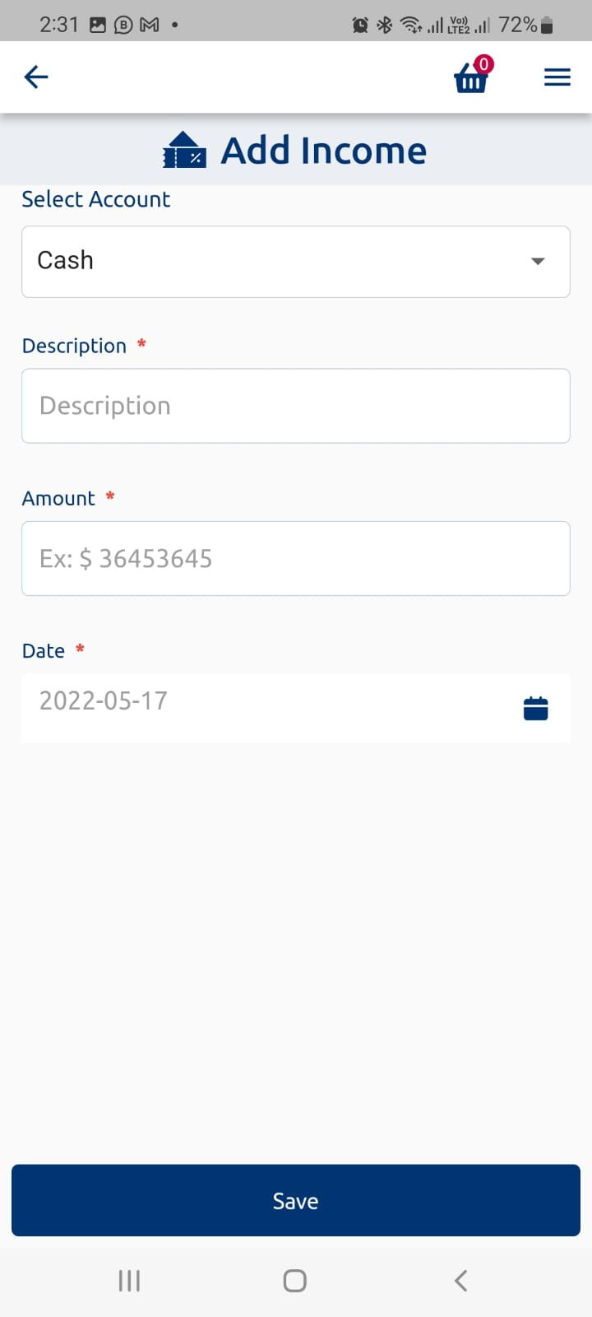
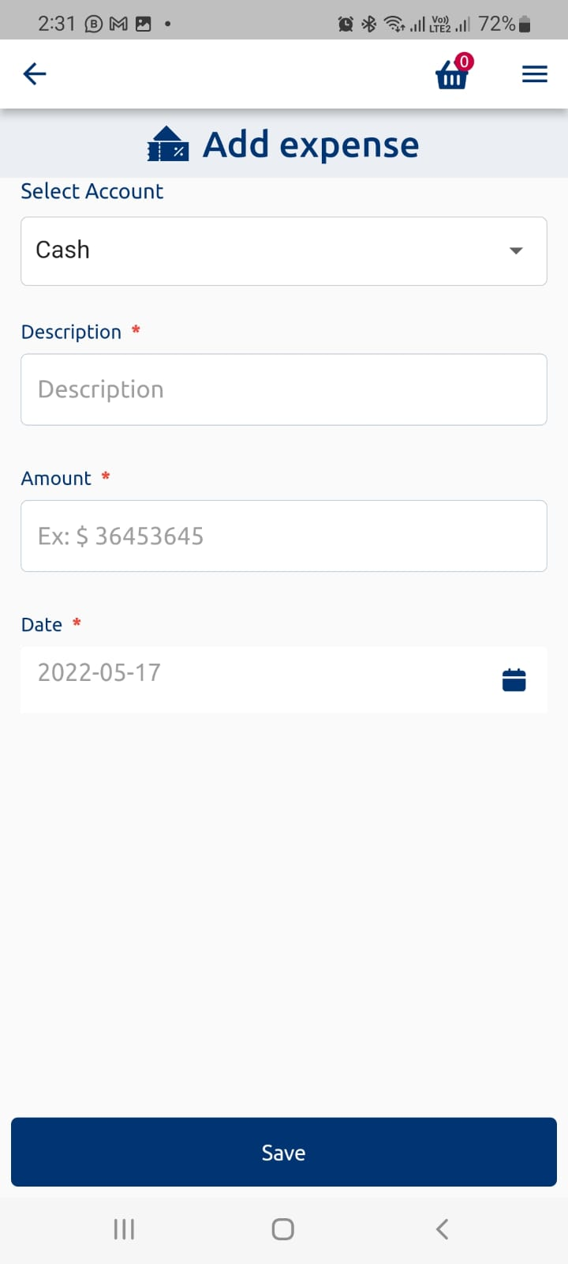
Action Points
In both add income and add expanse there should be a category head. and shopper can add category head by pop-up and he can see the report category head wise as well. Similar it will be added in the dashboard as well.

Slide 7
Module 2 : Purchase Module

Slide 8
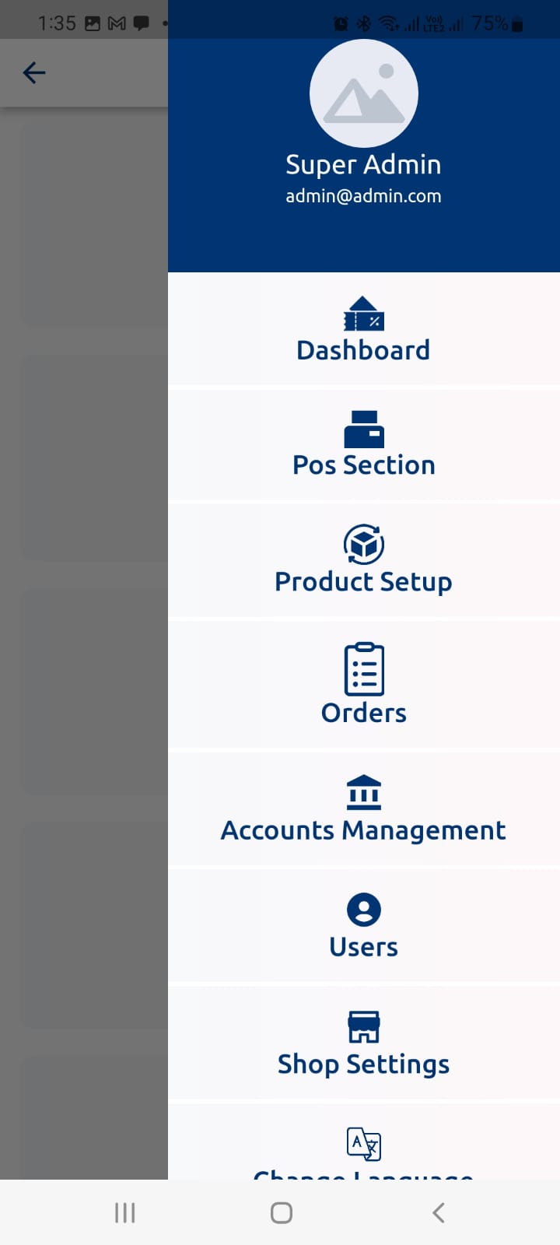
Action Points
Purchase Module to be added which should be linked with Products when inbounding it
It will be linked with supplier field already present.

Slide 9
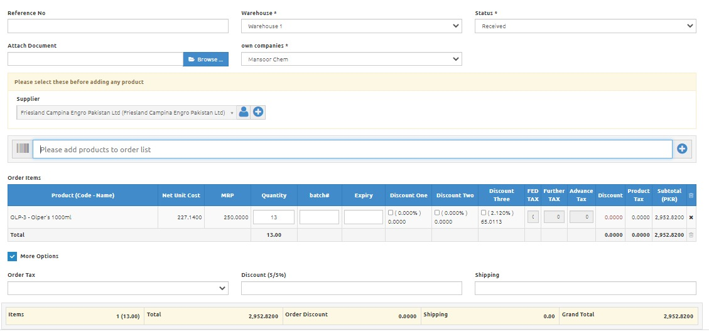
Brand:

Slide 10
Module 3 : Registration, Subscription and central database with images, barcodes, title name and MRP

Slide 11
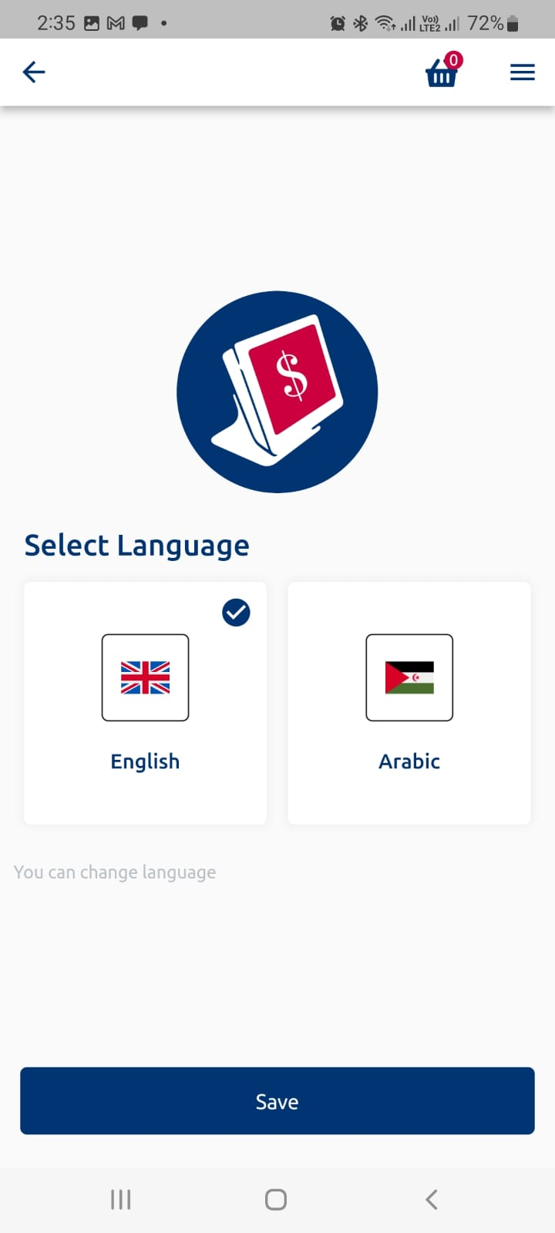
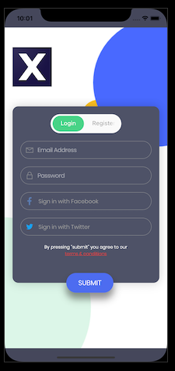
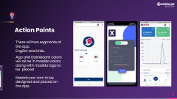
Action Points
There will two segments of the app. English and Urdu.
App and Dashboard colors will all be in maaldo colors along with maaldo logo to be placed
Maaldo pos icon to be designed and placed on the app.

Slide 12
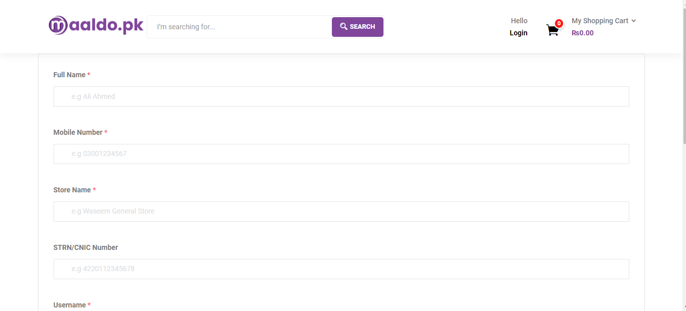
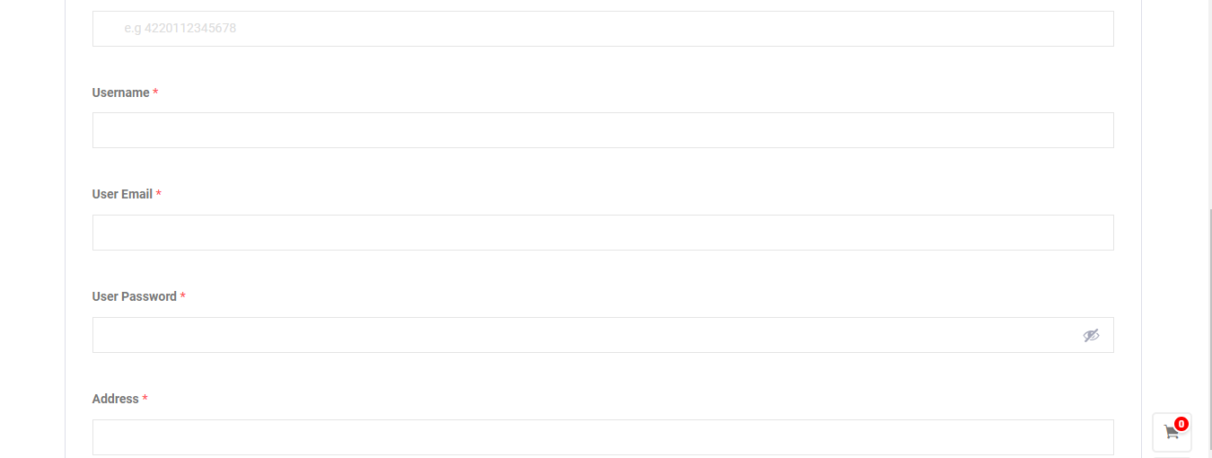
Action Points
Retailer (Dukaandar) will register on the app from where maaldo team will provide him username and password after shop verification with tagging the shop location pin option also available along with set of questions and answers. NIC/NTN field will not be compulsory
It will be monthly subscription mpos with two packages basic and pro. In basic there will be no access to digital repository and other one will be with access to digital repository. Basic will be 1000/- per month Pro will be 3000/- per month. Adding a user will be cost around 500/- per user. Retailer can pay through bank transfer, or payment gateway. On non-payment his access will expire after 10 days of non-payment
Data will be centralized. Shops mpos will be treated as branches. Maaldo team will have all access of shops sales and inventory of any particular shop

Slide 13
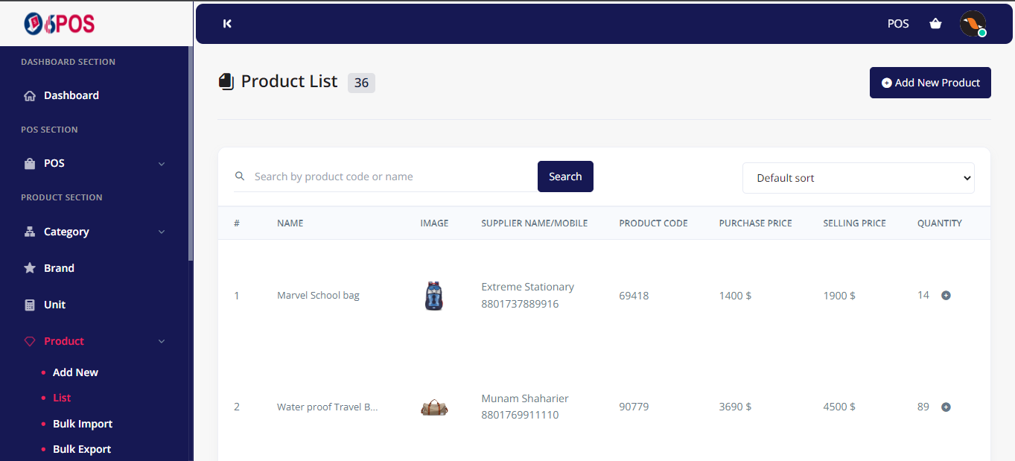
Action Points
This Product module will be centralized, and it will be assigned to each dukandar who registers for pro package. Where pictures, title name, quantity, product code and description access will be given to them, they can input the quantity, purchase price and selling price.
There will be alert quantity stock alert as well in the product list where shopper will input in on their own. In phase 2, there will be once the alert quantity of any sku reaches there will be a option of order through maaldo

Slide 14

Let’s Talk
Phone Number
+92 300 034 3015
Email Address
info@maaldo.pk
Download Maaldo.pk App:
https://play.google.com/store/apps/details?id=com.maaldo.maaldoapk

